Slide 1
CSS background and Layout Properties
Session 7
(slot 12)

Slide 2
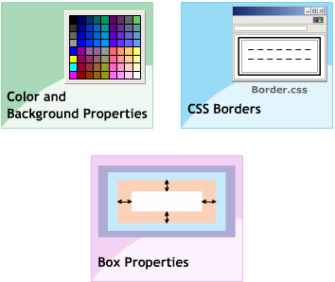
contents
Color and Background Properties
CSS Border
Box Properties

Slide 3
Color and Background Properties
Explain the syntax of color properties
Explain the background properties

Slide 4
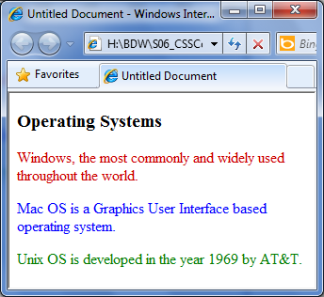
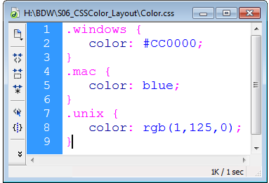
Color Properties
Color properties specifies the foreground color of an element.
Syntax:
color: <value>

Slide 5
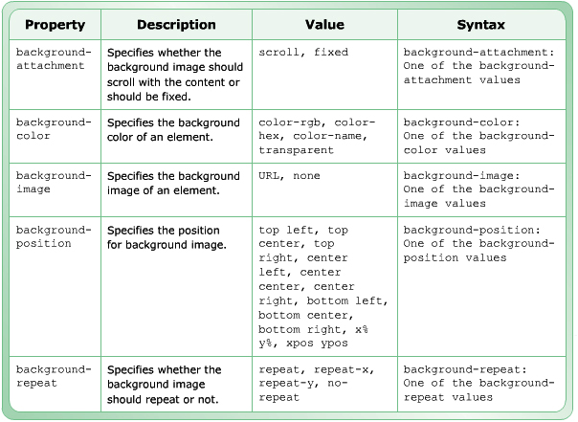
Background Properties

Slide 6

Background Properties
body {
background-image: url(Greeting.jpg);
background-repeat: repeat-y;
background-attachment: fixed;
}
div {
background-color: #FFFF00;
text-align: right;
}
- - - - - - - - - - - - - - - - - - - - - - - - - - - - - - - - -
<html>
<head>
<title>Welcome</title>
<link href="Background.css" rel="stylesheet" type="text/css”/>
</head>
<body>
<h2>Welcome to FPT University.</h2>
<div><p>Dream of Innovation </p></div>
</body>
</html>

Slide 7
CSS Border
Describe border style properties
Describe border color properties
Describe border width properties
Describe shorthand border properties

Slide 8
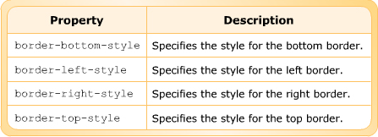
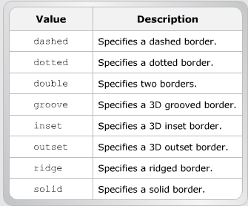
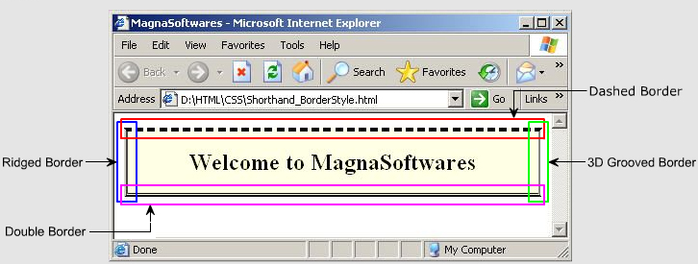
Border Style Properties

Slide 9
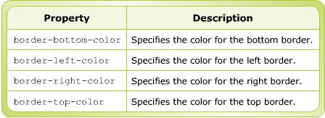
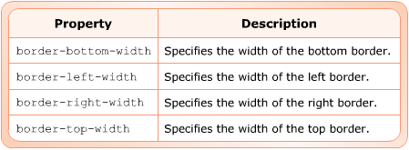
Border Color, Border Width Properties
.tip {
background-color: lightcyan;
border-top-color: #0000FF;
border-right-color: #FF0000;
border-bottom-color: #FF00FF;
border-left-color: #FFFF00;
border-style: double;
border-width: 20px;
}
img {
border-style: dashed;
border-color: #CC00FF;
border-top-width: 20px;
border-left-width: thick;
border-right-width: thin ;
}

Slide 10
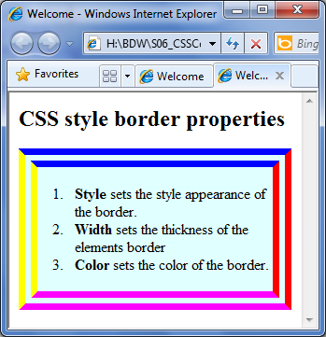
Border Color Properties
<html>
<head>
<title>Welcome</title>
<link href="BorderColor.css" rel="stylesheet" type="text/css">
</head>
<body>
<h2>CSS style border properties</h2>
<div class="tip">
<ol>
<li><b>Style </b>sets the style appearance of the border.</li>
<li><b>Width </b>sets the thickness of the elements border</li>
<li><b>Color </b>sets the color of the border.</li>
</ol>
</div>
</body>
</html>

Slide 11
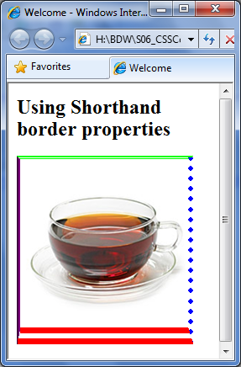
Shorthand Border Properties
.myshorthand {
border-top: dashed double #00FF00;
border-bottom: #FF0000 20 double;
border-right: dotted #0000FF thick;
border-left: inset medium rgb(255,0,255);
}
- - - - - - - - - - - - - - - - - - - - - - - - - - - - - - - - - - - - - - -
<html>
<head>
<title>Welcome</title>
<link href="ShorthandBorderColor.css" rel="stylesheet" type="text/css">
</head>
<body>
<h2>Using Shorthand border properties</h2>
<img class="myshorthand" src="Cup.jpg" width="200" height="200" />
</body>
</body>
</html>

Slide 12
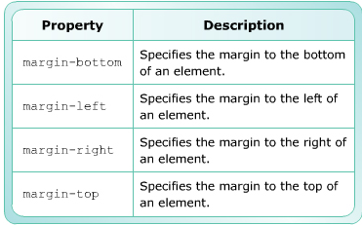
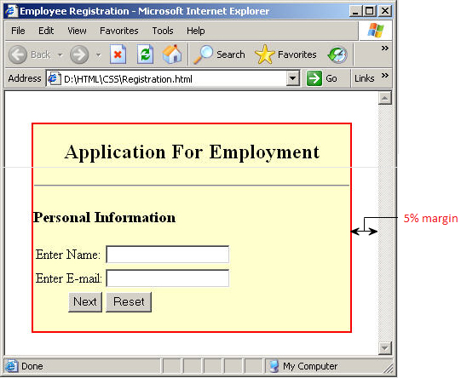
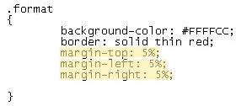
Box Properties: Margin

Slide 13
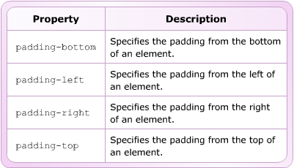
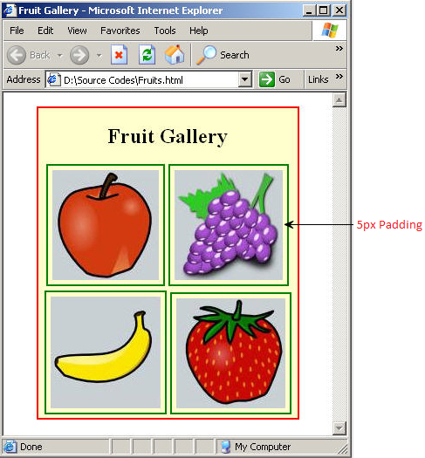
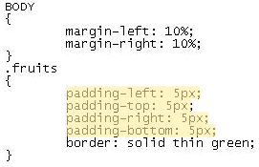
Box Properties: Padding

Slide 14
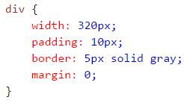

Box Properties: Box-sizing
This makes sure that the padding and border are included in the total width and height of the
Total width: 320 + 20(left+right padding)+ 10(left+right border) +0 (left+right margin)=350px
<img src=“hoa.jpg” width=“350” height=“263” />
<div> The picture above is 350px wide.</div>

Slide 15
Summary
CSS provides various properties that allow to define foreground and background color.
CSS provides background properties that specify the background color and image for Web pages.
CSS provides border properties that allow to create borders around text and images to give effective pleasing. Border properties specify the color, type and width of the border.

Slide 16
Summary…
The Box property includes: Margin and Padding properties.
The Margin property is a shorthand property that specifies the all four margin around the content just one declaration.
The Padding property is a shorthand property that specifies the padding for all the side in just one declaration.

